Slide 1

BLOCKCHAIN FOR CHARITY
Name-Anushka Mitra
Enrollment number-12020002016003

Slide 2
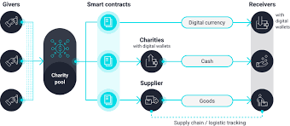
Analyse how blockchain can increase transparency and traceability in charitable donations.
ABSTRACT
In a world where trust and transparency in charitable organizations are often questioned, the implementation of blockchain technology has emerged as a promising solution to ensure the integrity of donations. Blockchain technology has the potential to significantly increase transparency and traceability in charitable donations. It aims to revolutionize the way charitable contributions are made and managed, with a core focus on transparency, accountability, and impact.

Slide 3
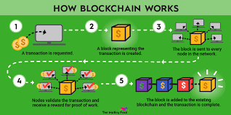
INTRODUCTION
This report explores the transformative potential of blockchain technology in the context of charitable donations, focusing on how it can significantly enhance transparency and traceability within the charitable sector. Charitable organizations play a crucial role in addressing societal challenges and trust and accountability are paramount in ensuring that funds are used effectively for their intended purposes. However, concerns about mismanagement, fraud, and lack of transparency have, at times, eroded public trust in charitable activities. Blockchain technology offers a promising solution to address these concerns by providing a secure and immutable ledger for tracking donations and their utilization.
In this report, we will delve into the key mechanisms through which blockchain can revolutionize the charitable donation landscape. We will examine the core features of blockchain technology that make it particularly well-suited for this purpose, including its immutability, decentralization, and transparency.

Slide 4
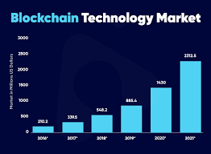
ABOUT BLOCKCHAIN
Blockchain technology is a groundbreaking and decentralized system that has revolutionized the way data is recorded and transactions are conducted. It functions as a distributed ledger, comprised of a chain of blocks, each containing a record of multiple transactions. What sets blockchain apart is its immutability; once information is added to a block, it cannot be altered or deleted, making it inherently secure and tamper-proof. This technology eliminates the need for intermediaries, offering transparency and trust in a wide range of applications beyond cryptocurrencies, including supply chain management, voting systems, and financial services. Blockchain's potential to enhance transparency, security, and efficiency continues to drive innovation across industries, promising a more decentralized and interconnected future.

Slide 5
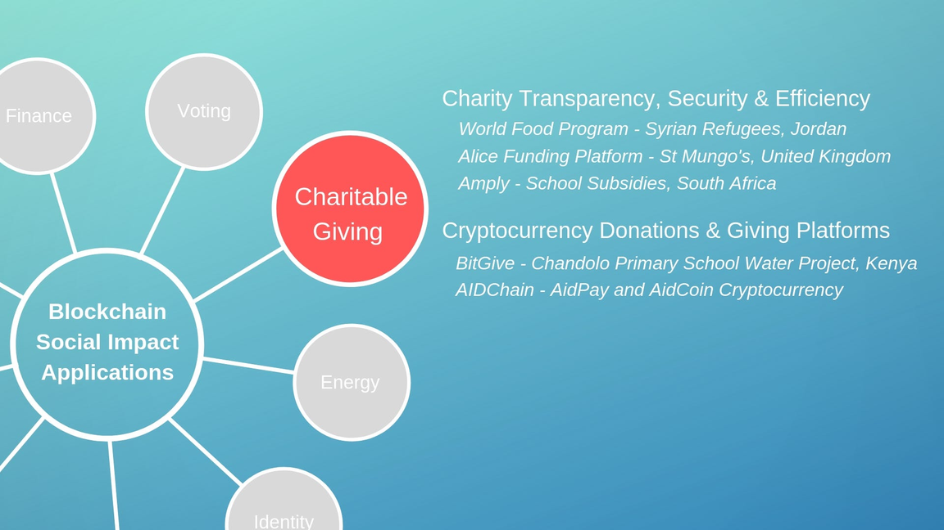
PROJECT OVERVIEW
The implementation of blockchain technology in charitable donations fundamentally transforms the way donation processes work. When a donor contributes, the transaction details, including the amount, timestamp, and donor's identity (if desired), are securely recorded on an immutable and decentralized blockchain ledger. This ledger is publicly accessible, ensuring full transparency, while also providing end-to-end traceability of funds. Donor privacy is maintained as personal information is not stored on the blockchain, and auditability becomes seamless, simplifying regulatory compliance. Blockchain revolutionizes charitable donations by instilling trust, streamlining processes, and ensuring that funds reach their intended beneficiaries with transparency and accountability.

Slide 6
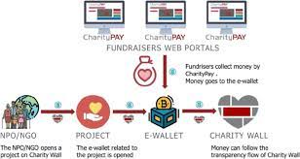

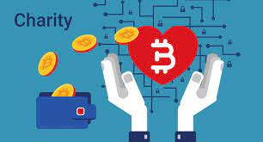
Features of
Block chain Technolgy
The transparent nature of blockchain ensures that all transactions are publicly recorded. Anyone can view the donation ledger, providing an open and easily accessible record of all contributions and disbursements. Donors can independently verify the flow of funds, ensuring their donations reach their intended destinations.
Immutable Record Keeping:
Decentralization:
Blockchain operates on the principle of immutability. Once a donation transaction is recorded on the blockchain, it becomes a permanent and unalterable entry. This ensures that all donation records are tamper-proof and transparent.
Blockchain is decentralized, meaning it operates on a distributed network of nodes rather than a centralized authority. This decentralization eliminates the need for intermediaries, reducing the risk of mismanagement and allowing for greater transparency.
Auditing and Compliance
Blockchain simplifies auditing processes for charitable organizations. Auditors can access a complete and transparent history of financial transactions, making it easier to ensure compliance with regulatory requirements and financial integrity.

Slide 7





REAL LIFE APPLICATIONS
Blockchain-Based Donation Platforms
Identity Verification and Trust Building
Supply Chain and Aid Distribution
Transparent Fundraising Campaigns
·Several blockchain-based platforms have emerged, such as BitGive and Alice, that facilitate transparent donations. These platforms record all transactions on a blockchain, allowing donors to trace their funds and see how they are used by charities.
,
·Blockchain can be used to verify the identities of charitable organizations and their beneficiaries. This helps donors ensure that their contributions are reaching legitimate causes and recipients. The World Food Programme (WFP) has piloted a blockchain-based system to provide food assistance to Syrian refugees.
·Blockchain can be employed to track the distribution of aid supplies. For instance, the United Nations uses blockchain to trace the delivery of food and medical supplies to refugee camps, reducing the risk of fraud and ensuring that aid reaches those in need.
·Charities can use blockchain to run transparent fundraising campaigns. Donors can see how much money has been raised in real-time and how it is being utilized. The Tap Project, for instance, uses blockchain to track donations for clean water projects.

Slide 8

CHALLENGES OF BLOCKCHAIN TECHNOLOGY
1. Technical Complexity
2. Scalability Issues
3. Fraud and Security Risks
Blockchain networks like Bitcoin and Ethereum have faced scalability issues, leading to slow transaction processing times and high fees during peak periods. This can hinder the efficiency of donation processing, especially during emergencies when rapid response is critical.
Blockchain technology can be complex to implement and maintain. Charitable organizations may lack the technical expertise and resources needed for blockchain integration, leading to barriers to adoption.
While blockchain is secure, it is not entirely immune to fraud. Hackers can exploit vulnerabilities in smart contracts or compromise private keys, leading to the loss of donated funds.
Different blockchain networks may not easily communicate or share data. This can lead to fragmentation and hinder the seamless flow of donations and information across different platforms.

Slide 9

FUTURE WORK
Future work in the application of blockchain for transparency and traceability in charitable donations should focus on addressing key challenges and maximizing the technology's potential. This includes developing user-friendly interfaces and educational materials to ensure broader adoption among donors and charitable organizations, particularly those with limited technical expertise. Additionally, efforts should be made to establish global standards and regulatory frameworks for blockchain-based donations to ensure compliance and protect donor rights across jurisdictions. Exploring energy-efficient blockchain solutions to mitigate environmental concerns, as well as building interoperability between different blockchain networks, can enhance the scalability and efficiency of charitable donation systems. Moreover, ongoing research and development should prioritize privacy-enhancing features to protect sensitive donor information while maintaining transparency. Collaboration between the blockchain community, nonprofit organizations, and governments will be essential in shaping the future of charitable donations, making them more transparent, accountable, and accessible to all.

Slide 10



CONCLUSION
Blockchain technology presents a groundbreaking approach to enhance transparency and traceability within the realm of charitable donations. Through the recording of donation transactions on an unchangeable, decentralized ledger, it establishes a clear and immune-to-tampering record of how funds move. Consequently, donors gain the ability to verify the impact of their contributions and follow the entire journey of their donations, instilling confidence, and accountability in the charitable domain. Additionally, the integration of smart contracts and automation facilitates efficient and secure fund distribution, trimming administrative expenses and ensuring that a greater proportion of resources reaches their designated recipients. This underscores the blockchain's potential as a formidable instrument for revolutionizing philanthropy.

Slide 11
THANK YOU

